Slide 1
Module 11 Condition Monitoring of Equipment Using Motor as a Transducer
Dr. Belle R. Upadhyaya
Seyed A. Niknam
College of Engineering
Nuclear Engineering Department
The University of Tennessee
© 2014

Slide 2
Outline
Electrical signature analysis as a complementary approach to vibration and pressure pulsation analysis.
Computation of motor power.
Case study of application to detection of broken rotor bars in an induction motor.
Case study of application to detection of misalignment.
Application to condition monitoring of motor-operated valves (MOVs).

Slide 3
Introduction
Condition monitoring of electrical systems includes both stationary components and rotating machinery.
Examples of stationary components: Cables, instrument channels, electrical circuits, etc.
Causes of degradation include: bad connections, ground faults, excess heat, internal shorts, low insulation resistance, moisture intrusion, etc.
Examples of rotating machinery: AC and DC machines, motor-actuated devices (such as valves and other actuators), and equipment that are coupled to electrical machinery.

Slide 4
Introduction
The diagnosis of both the driving and driven machinery can be performed by using the electrical properties of the motor as a transducer.
Short-term operational, as well as long-term aging of electrical equipment and their maintenance is an important issue in all industries.
The general approach for diagnosis is to compare test data with data from baseline conditions.

Slide 5
Motor Failure Modes
Principal damage mechanisms that lead to the failure of motors are:
Overheating
Insulation breakdown
Mechanical failures
Motor circuit faults
In some cases the root cause of motor anomalies may be traced to harmonics in the line frequency of the external power supply.

Slide 6
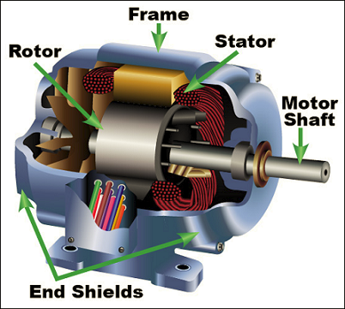
Motor Failure Modes
Percent of failure modes as given by major motor components:
Bearing related ≈ 40%
Stator related ≈ 35%
Rotor related ≈ 10%
All Others ≈ 15%
www.techtransfer.com

Slide 7
Motor as a Transducer
Whenever the load on an induction motor changes, the current drawn by the motor changes. Changes in both frequency and magnitude characteristics are seen in the motor current and motor power signatures.
Therefore, the broad-band measurement of line current with a simple current transducer (along with voltage) may be used to perform diagnostics of motor faults and driven equipment.

Slide 8
Motor as a Transducer: Complementary Measurement
In most cases, mechanical and some electrical-related problems can be detected and isolated using vibration analysis, combined with thermography, lubrication oil analysis, and process analysis (using pressure and temperature measurements).
Electrical signature analysis provides an alternative approach to machinery monitoring and often can be used to confirm results from the other condition monitoring techniques.

Slide 9
Motor as a Transducer: Complementary Measurement
Electrical measurements are non-evasive and can be performed at the motor control center. It is not necessary to be near large equipment to make the measurements.
This is especially advantageous in monitoring large horsepower motors, and motor-driven equipment located in radioactive or chemically toxic environment.

Slide 10
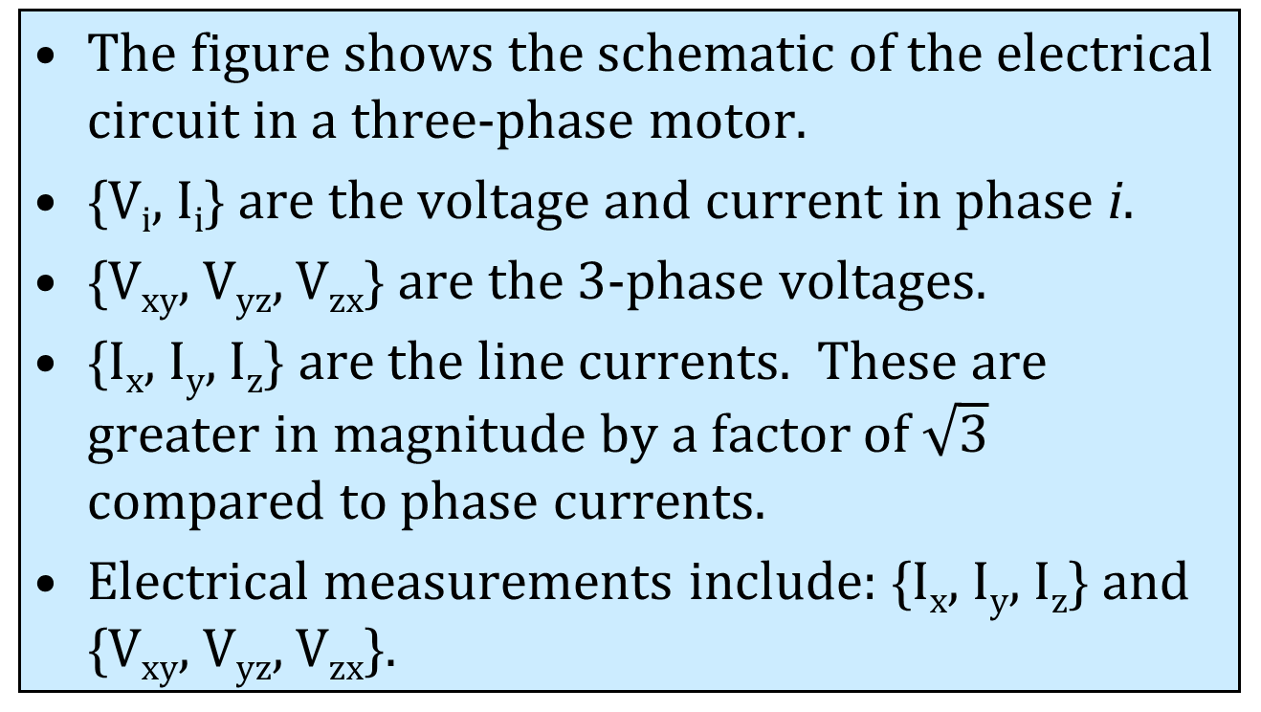
Power Input to a Three-Phase Induction Motor
The figure shows the schematic of the electrical circuit in a three-phase motor.
{V_{i}, I_{i}} are the voltage and current in phase i.
{V_{xy}, V_{yz}, V_{zx}} are the 3-phase voltages.
{I_{x}, I_{y}, I_{z}} are the line currents. These are greater in magnitude by a factor of $\sqrt{3}$ compared to phase currents.
Electrical measurements include: {I_{x}, I_{y}, I_{z}} and {V_{xy}, V_{yz}, V_{zx}}.

Slide 11
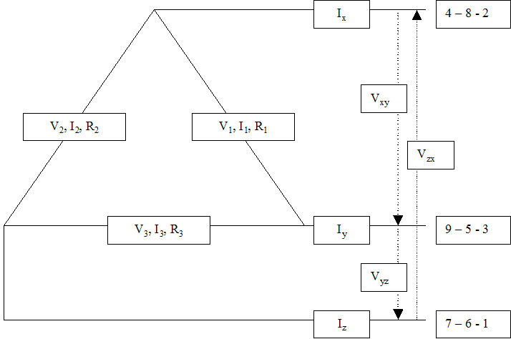
Schematic of a Three-phase Motor Showing Currents and Voltages

Slide 12
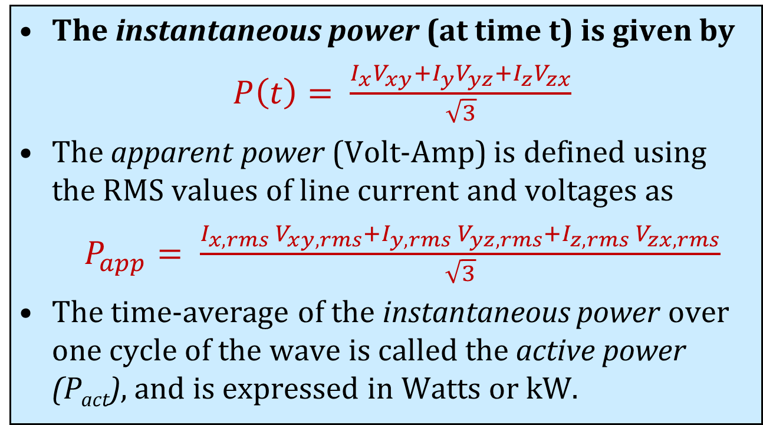
Power Input to a Three-Phase Induction Motor
The instantaneous power (at time t) is given by
$P\left(t\right)= \frac{I_{x}V_{xy}+I_{y}V_{yz}+I_{z}V_{zx}}{\sqrt{3}}$
The apparent power (Volt-Amp) is defined using the RMS values of line current and voltages as
$P_{app}= \frac{I_{x,rms} V_{xy,rms}+I_{y,rms} V_{yz,rms}+I_{z,rms}{ V}_{zx,rms}}{\sqrt{3}}$
The time-average of the instantaneous power over one cycle of the wave is called the active power (P_{act}), and is expressed in Watts or kW.

Slide 13
Case Study: Detection of Broken Rotor Bars in an Induction Motor
When a broken rotor bar is present in a rotor, the current pattern at the broken bar changes, causing additional loads on the motor, and modulates the line current drawn by the motor.
This effect shows up as side bands of the line current frequency
Side-band frequencies: f_{l} ± N_{p} f_{s} (and its harmonics)
The energy at the side band frequency increases as compared to the energy at the line frequency.

Slide 14
Case Study: Detection of Broken Rotor Bars in an Induction Motor
Figures show the no-load and full-load motor current spectra of an induction motor with 52 rotor bars. The motor has N_{p}= 4 poles with a synchronous frequency, f_{m} = 30 Hz.
No-load slip frequency = 30-29.51 = 0.49 Hz.
Side-band frequency spacing at no-load
= 4 x 0.49 = 1.96 Hz.
No-load side-band frequencies of 60 Hz are at
60 ± 1.96 = 58.04 Hz and 61.96 Hz

Slide 15
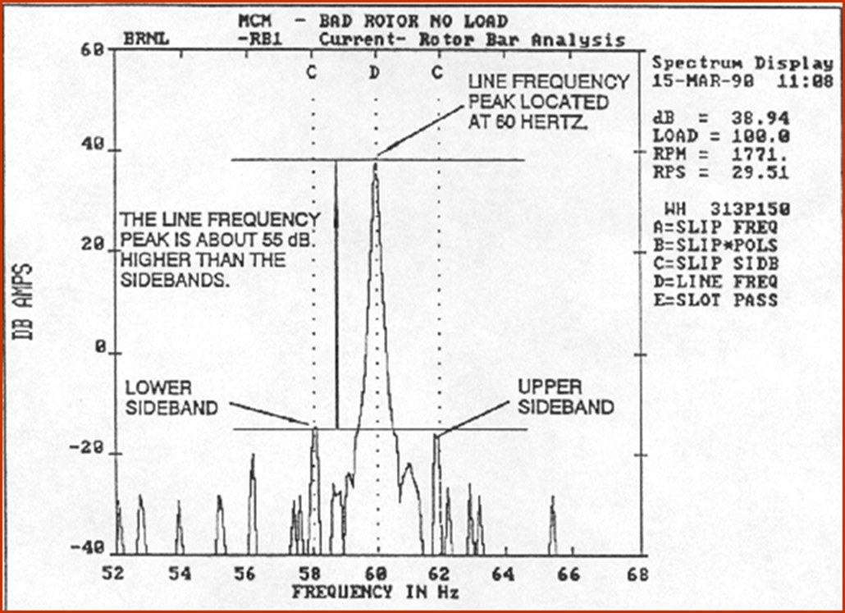
Motor Current Frequency Spectrum at No-Load Operation

Slide 16
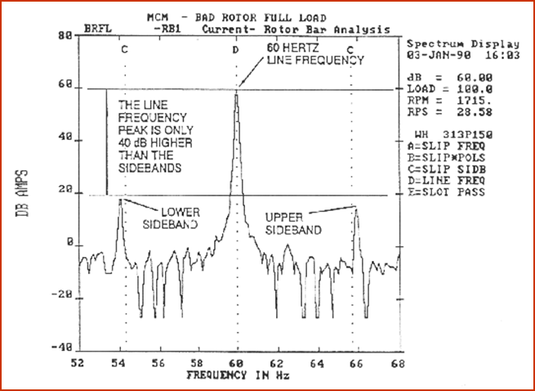
Motor Current Frequency Spectrum at Full-Load Operation

Slide 17
Case Study: Detection of Broken Rotor Bars in an Induction Motor
Full-load slip frequency = 30-28.58 = 1.42 Hz.
Full-load side-band frequency spacing
4x1.42 = 5.68 Hz.
Full-load side-band frequencies of 60 Hz are at
60 ± 5.68 = 54.32 Hz and 65.68 Hz.
Note the increase in the side-band magnitudes (dB) from no load to full load.
This information may be trended for maintenance scheduling and life prediction.

Slide 18
Case Study: Detection of Broken Rotor Bars in an Induction Motor
An estimate of the number of rotor bars may be made using empirically derived relationship between spectral magnitudes and number of broken or cracked rotor bars, N.
N = 2R/{10^{(ΔdB/20)} + N_{p}}
R = Number of rotor bars or slots
ΔdB = dB amplitude difference between line frequency and lower side-band frequency.
N_{p} = Number of stator poles

Slide 19
Case Study: Detection of Broken Rotor Bars in an Induction Motor
Example calculation
R = 52
ΔdB ≈ 40
N_{p} = 4
N = 2R/{10^{(ΔdB/20)} + N_{p}}
An estimate of the number of broken rotor bars
N = 2(52)/{10^{(40/20)} + 4} ≈ 1

Slide 20
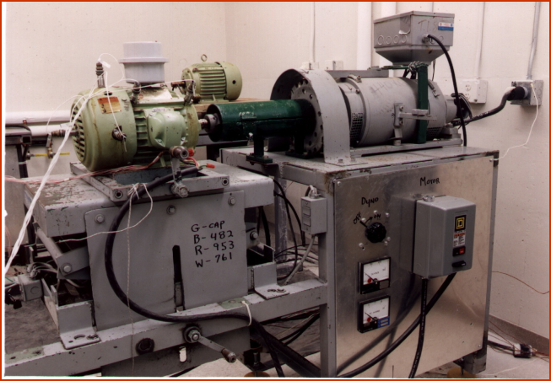
Motor Testing Laboratory: Motor is coupled to a dynamometer

Slide 21
Case Study: Detecting Equipment Misalignment Using Motor Power
Misalignment results in not only axial and radial vibration, but torsional loading also. Because of this the motor is a sensitive transducer of misalignment.
Figures show power spectra for three cases
Tests were performed on a 10-HP, 4-pole motor with a dynamometer for loading.
Well-aligned system shows low vibration and power signatures.

Slide 22
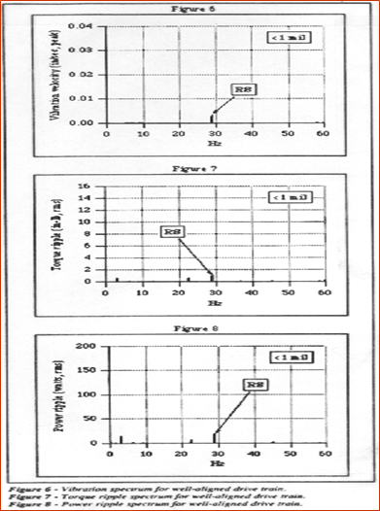
Vibration, Torque and Motor Power Spectra for the Well-aligned case

Slide 23
Case Study: Detecting Equipment Misalignment Using Motor Power
Motor inboard vibration, output torque and input power are shown for the misaligned cases:
Motor outboard feet elevated by 20 mils.
Motor outboard feet elevated by 30 mils.
The amplitude of the vibration is very low even for the most severely misaligned condition (motor inboard feet elevated by 40 mils).
The motor power changes are very significant indicating that equipment misalignment can be detected by electrical signatures.

Slide 24
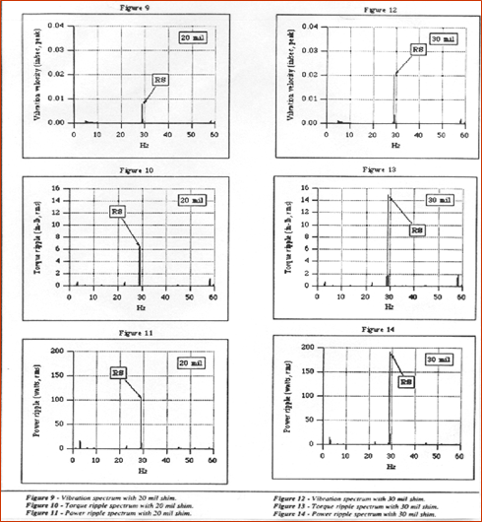
Vibration, Torque and Motor Power Spectra for misalignment cases with 20-mil shim and 30-mil shim

Slide 25
Condition Monitoring of Motor-Operated Valves (MOVs)
Condition monitoring of valve systems is an important operational issue in power and process industries.
About 20% of unscheduled outages in nuclear plants are valve-related, and up to 30% of annual maintenance budget is devoted to valve maintenance.
Load cycling duty in fossil plants causes high stresses in steam and feed water control valves.

Slide 26

Condition Monitoring of Motor-Operated Valves (MOVs)
Types of valve actuators:
Motor-operated valves (MOVs)
Air-operated valves (AOVs)
Check valves
Solenoid-operated valves (SOVs)
Industrial Valve Usage in the U.S.

Slide 27
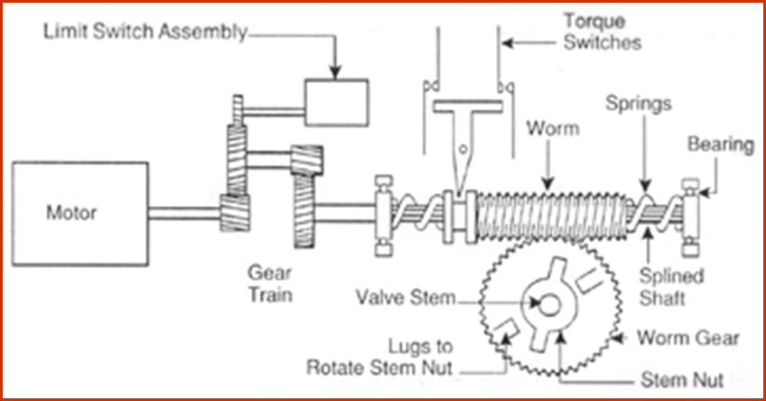
Schematic of a Motor-Operated Valve System

Slide 28
Motor-Operated Valve
MOVs are used in systems with large line size, high pressure, flow rate, or inaccessible location (e.g. piping systems)
Mainly for on-off application
Worm gears:
To generate high thrust force
Transmit motion between non parallel shafts
Just the worm can turn the gear
Large gear reductions

Slide 29
Possible Anomalies in MOVs
Bent valve stem
Increased packing friction
Torque and limit switch settings
Changes in stroke time
Improper valve seating, seating obstruction.
Worm gear tooth
Wear, fatigue or plastic deformation
Influence the kinematic accuracy

Slide 30
Types of Failure Modes in MOVs
Mechanical (22%): Bent stem, damage to valve seats, gear binding and damage.
Electromechanical (32%): Torque switch failure, torque switch adjustment, limit switch adjustment.
Electrical (27%): Motor, contacts, etc.
All others (19%): Vibration, wear, etc.

Slide 31
Motor Current Signature Analysis (MCSA)
Time domain analysis of motor current during open-to-close and close-to-open strokes provides diagnostic information about various valve stroke events, including magnitudes and timings.
Valve anomalies may be detected by careful analysis of the motor current signature.
This technique is non-evasive and can be used for in-service inspection.

Slide 32
Motor Current Measurement
Current Transformer
This device utilizes the line current being measured as a primary and develops a secondary current, or output, which is proportional to the primary current. There are clamp-on type and doughnut-type current transformers.
Figure shows a clamp-on meter, consisting of a ferrite core (surrounding the current carrying conductor) and a built-in secondary coil. Note that the clamp must always surround only one of the conductors (or wires).
This transducer is especially useful where conductors are carrying heavy currents, and where it is not convenient to open the circuit to insert an ammeter.

Slide 33
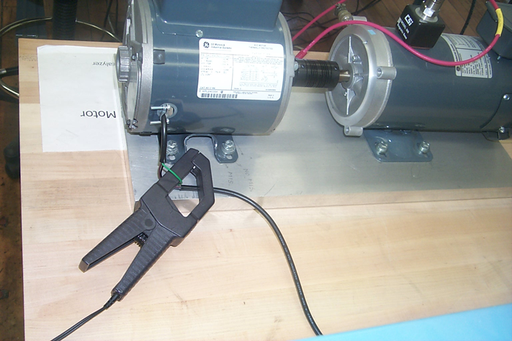
A Clamp-on Current Meter and a single current carrying conductor (green)

Slide 34
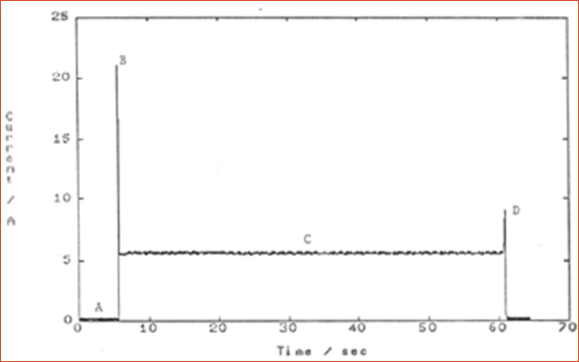
Motor current signature during the open-to-close stroke of an MOV

Slide 35
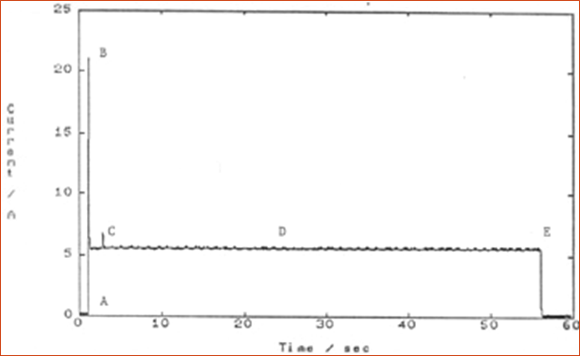
Motor current signature during the close-to-open stroke of an MOV

Slide 36
Frequency Domain Analysis of Motor Current Signal
Spectral peaks such as worm gear tooth-meshing frequency, stem nut rotation, shaft speed, motor slip frequency, etc. can be detected (see plot).
Harmonics of fundamental peaks and their sidebands indicate wear and/or eccentricity.
Remark: Motor power is found to be more effective when the load varies during valve strokes.

Slide 37
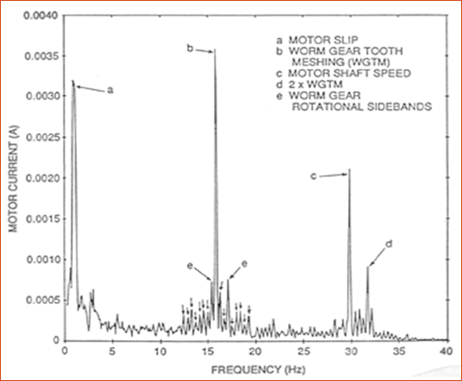
A typical MOV motor current frequency spectrum. New peaks may appear because of wear, imbalance.

